Slide 1




Historical Data Transformation
Employee Compensation and Performance Analysis
Data Analyst
By,
Rahulkannan

Slide 2

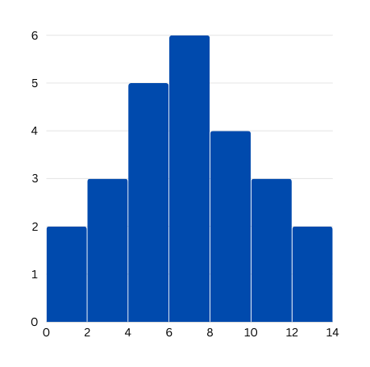

Task Overview:
Convert columnar employee data from an input CSV file into a structured, historical, row-based format. This format should include details such as compensation changes, engagement scores, and performance ratings over time, suitable for insertion into a data warehouse.

Slide 3


Approachs
Loading the Data
The dataset is loaded into a Pandas DataFrame using the read_csv() function.

Slide 4
2.Calculating Last Compensation and Last Pay Raise Date
We find the maximum compensation amount among the available columns (Compensation, Compensation 1, Compensation 2) to determine the last compensation.
We find the latest pay raise date by taking the maximum date among the Compensation 1 date and Compensation 2 date columns.

Slide 5

3.Calculating Variable Pay
Assuming that variable pay is 10% of the last compensation, we calculate the variable pay amount.

Slide 6
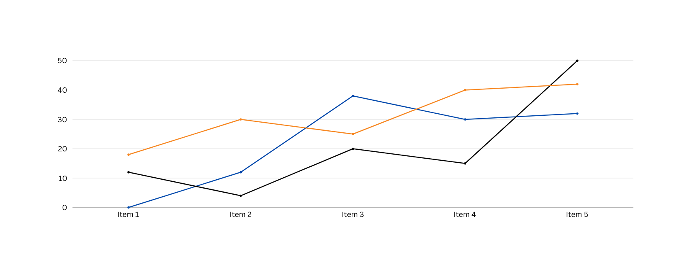
4.Calculating Tenure in the Organization
We calculate the tenure in the organization by finding the difference between the date of exit and the date of joining.

Slide 7

5.Calculating Performance Rating
I calculated the performance rating as the average of Review 1 and Review 2 scores.

Slide 8

6.Calculating Engagement Score
Similarly, the engagement score is calculated as the average of Engagement 1 and Engagement 2 scores.

Slide 9


Output
Finally, I selected and reordered the columns to create the output CSV file.

Slide 10

By,
Rahulkannan

